Slide 1
A/B testing
By Zhanna Kozlova

Slide 2

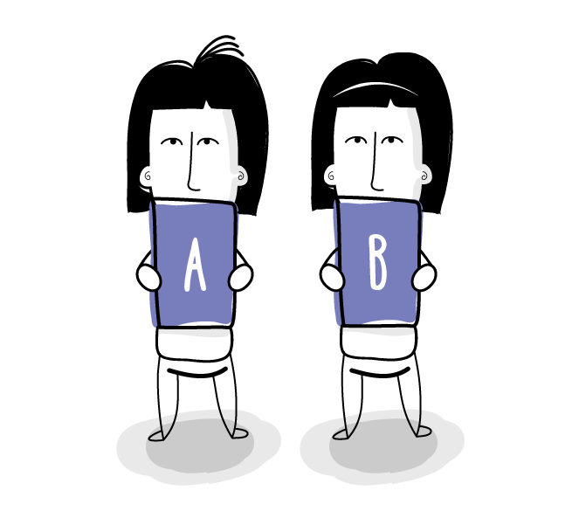

A/B testing
A/B testing is the process of comparing two variations of something, usually by testing users' response to variant A vs variant B, and concluding which of the two variants is more effective.

Slide 3
A/B testing
The A/B test can be considered the most basic kind of randomized controlled experiment.
You must estimate the sample size you need to achieve a statistical significance, which will help you make sure the result you’re seeing “isn’t just because of background noise”.

Slide 4
A/B testing
The test analyst should first divide the users by mobile and desktop and then randomly assign them to each version.
This is called blocking.

Slide 5
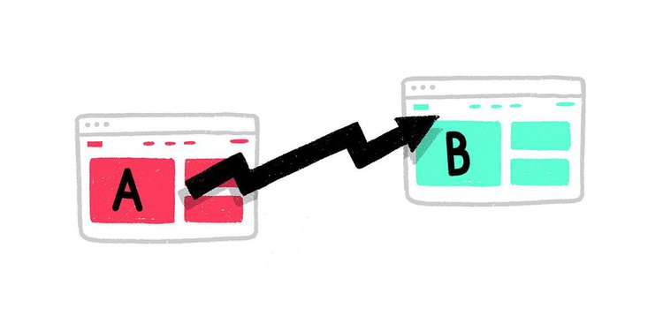
Why should I conduct “ A/B testing?”
A/B testing of landing pages can generate up to 30-40%
more leads for B2B sites;
20-25% more leads for eCommerce sites;
Only 40% of marketers validate test results.

Slide 6
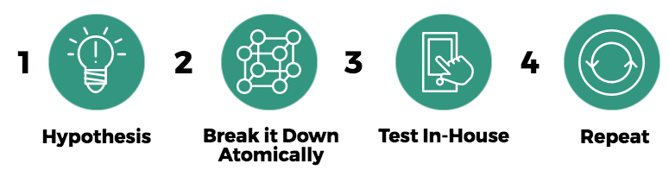

BOOKING’S EXAMPLE

Slide 7
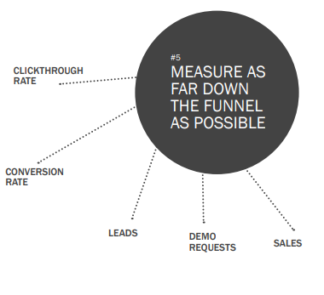
Guidelines for effective A/B Testing
#1 Only conduct one test at a time
#2 Test one variable at a time
#3 Test minor changes, too
#4 Measure as far down the funnel as possible

Slide 8
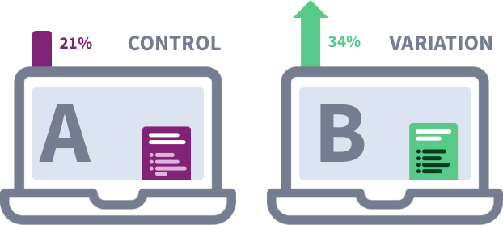
Guidelines for effective A/B Testing
#5 Set up control & treatment
• Variation A:
Control (the unaltered, original version)
• Variation B: Treatment (the optimized version which you expect to perform better)

Slide 9
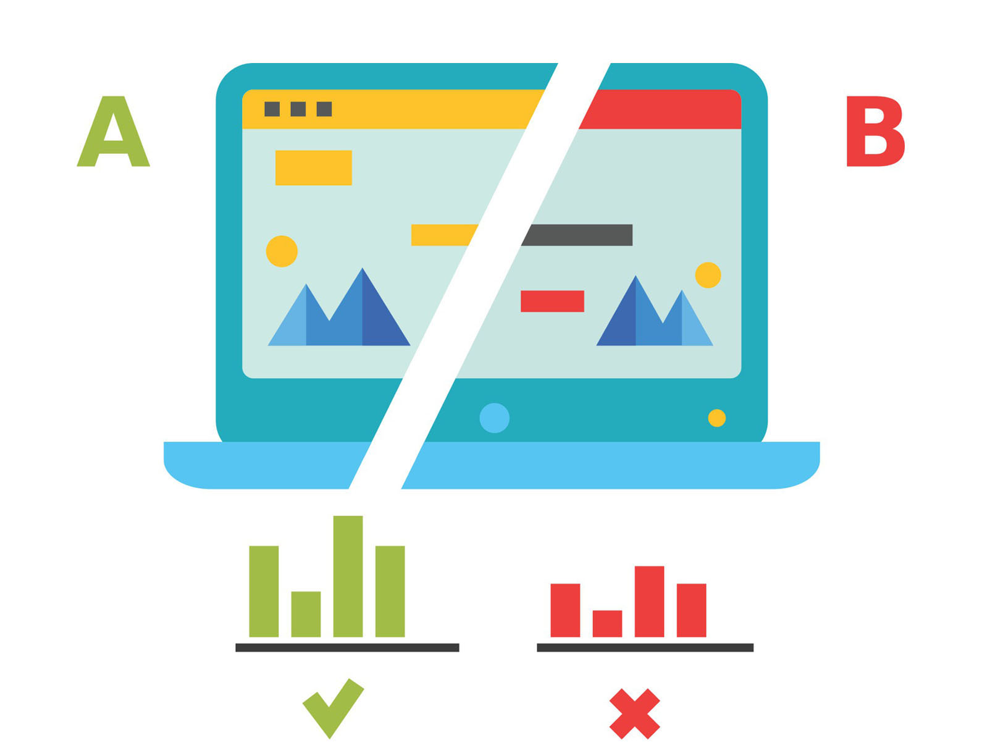
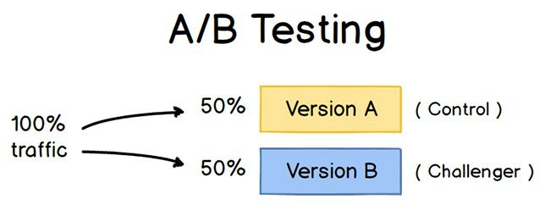
Guidelines for effective A/B Testing
#6 Decide what you want to test
#7 Split your sample group randomly
#8 Test at the same time

Slide 10
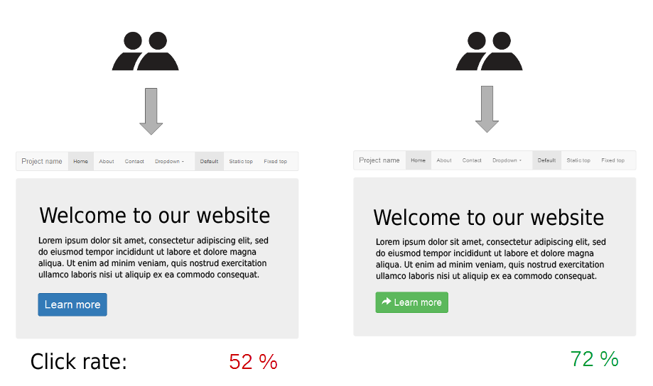
What Variables you should test
Landing pages:
OFFERS:
What types of offers convert the most visitors into leads and which offers help you push leads down the sales funnel?

Slide 11
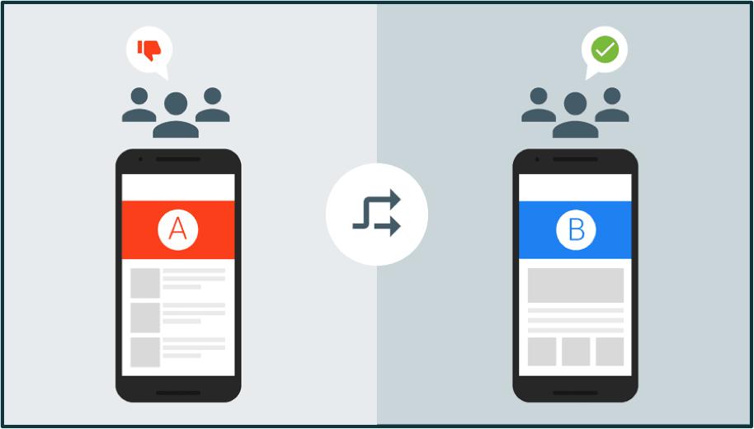
What Variables you should test
Landing pages:
TOPICS/COPY:
How should you position your offer? What messaging will entice your reader? Should you add testimonials to strengthen the visitor’s incentive?

Slide 12
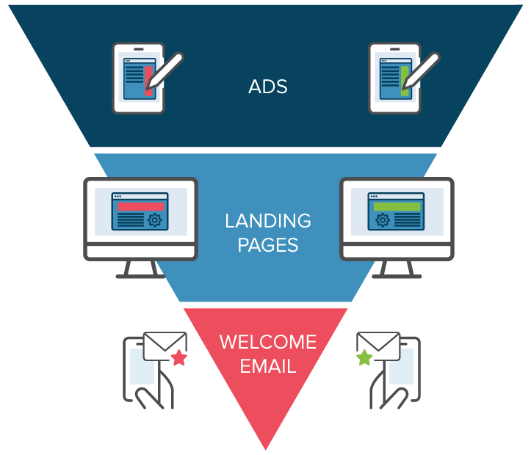
What Variables you should test
Landing pages:
FORM FIELDS:
Should your lead capture form only request an email address or should it ask for more information?
WHOLE PAGE

Slide 13

What Variables you should test
Call to action
PLACEMENT
According to an Eyetrack III study, the best placement of online ads is in the top and left position.
Copywriter Dean Rieck suggests that once your readers get used to a particular placement, they might start ignoring the call-to-action or ad.

Slide 14

What Variables you should test
Call to action
SIZE
Create an A/B test to see if a big call to-action that adds value to the message.
COLOR
COPY
GRAPHIC

Slide 15

Elements that you can optimize in your email:
FORMAT
LAYOUT
SENDER
SUBJECT LINE

Slide 16
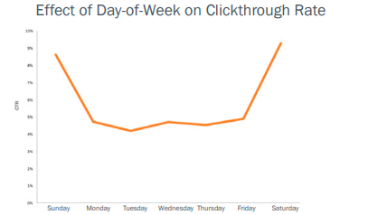
What Variables you should test
TIMING

Slide 17

Elements you shouldn’t bother testing:
Minor Text Changes
General Improvements

Slide 18

Types of A/B testing for mobile apps
In-app A/B testing
A/B testing for marketing campaigns

Slide 19
Why is A/B Testing Important in UX?
help you learn how small changes influence user behavior;
decide which approach towards design to implement;
confirms that a new design is going in the right direction.
Good UX will make users stay on a website or in the app – or will make them visit it again – while bad UX will do the opposite.

Slide 20
“Multivariate” testing in the A/B testing
A/B/C/D test

Slide 21
Analyzing A/B test results
One winning variation
-Before you ask your developer to implement the winning variations on the whole site, first determine whether the test results are valid.
allocate the 100% traffic to the winning variation.

Slide 22
Analyzing A/B test results
“The real interpretation is that if you ran your A/B test multiple times, 95% of the ranges will capture the true conversion rate — in other words, the conversion rate falls outside the margin of error 5% of the time (or whatever level of statistical significance you’ve set),”

Slide 23
Analyzing A/B test results
Multiple winning variations
-Segment test results just to see how your most valuable customers respond to the changes.
Analyzing the behavior of your visitors under these segments can help you reveal new insights about their perspective.

Slide 24
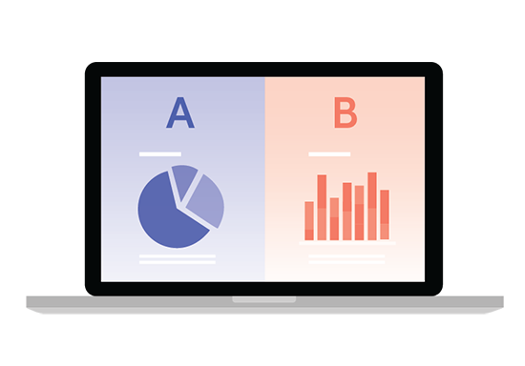
Qualitative a/b testing

Slide 25
Steps for gathering qualitative data for A/B tests
Get users to go through both variations of the design, with the same task and questions to avoid bias;
Ensure the order of presentation of the designs is counterbalanced;
Finally, compare the responses you received on variation A compared to the responses you received on variation B to see if there are any key themes, motivations, or barriers that stood out.

Slide 26


